Slide 1

Workshop Day 1 “This is about modern, open-source threat detection and security visibility.”
Trainer: Mirko Laquintana
Duration: ~2 hours | Online – Hands-on | October 20th

Slide 2


Slide 3
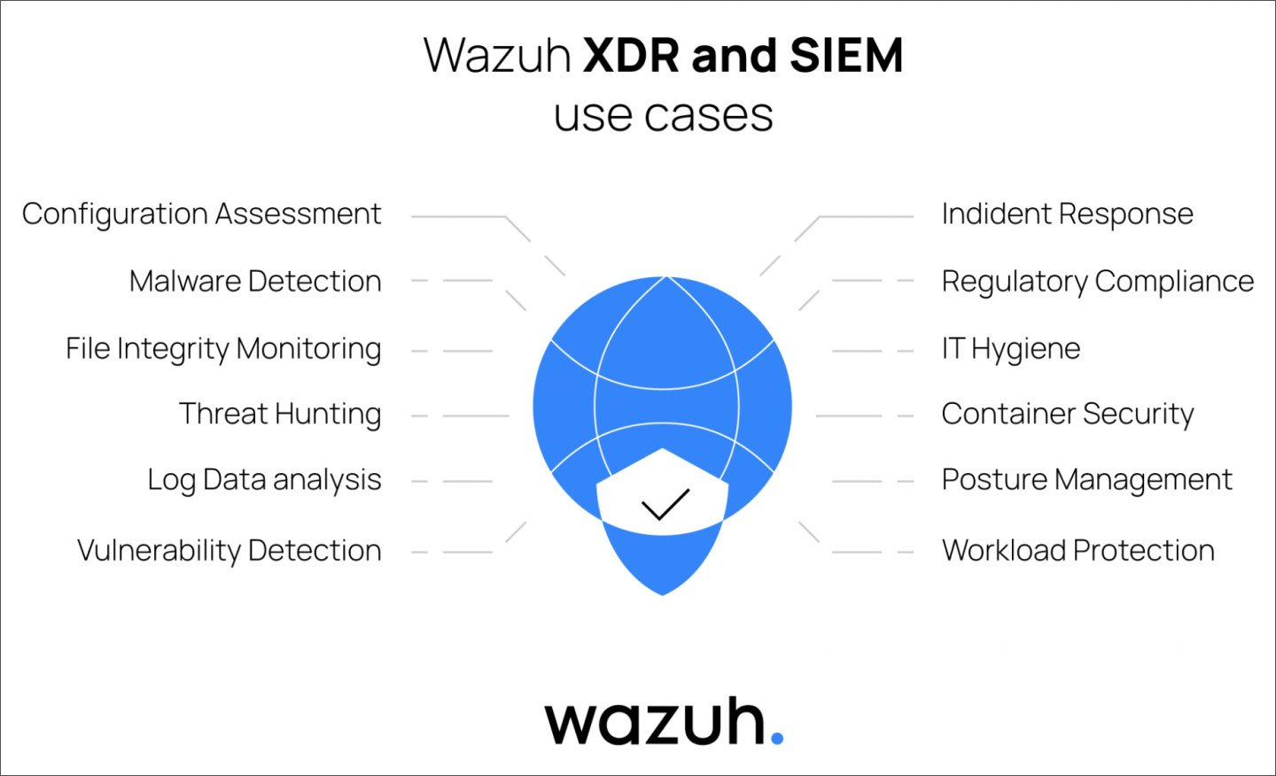
Why Wazuh? Use Cases and Training Objectives
Understand Wazuh architecture (Manager, Agents, Indexer, Dashboard)
Learn how to collect, decode, and analyze security events
Perform live threat-hunting exercises and interpret alerts
Experience hands-on detection with controlled Windows and attack scenarios

Slide 4
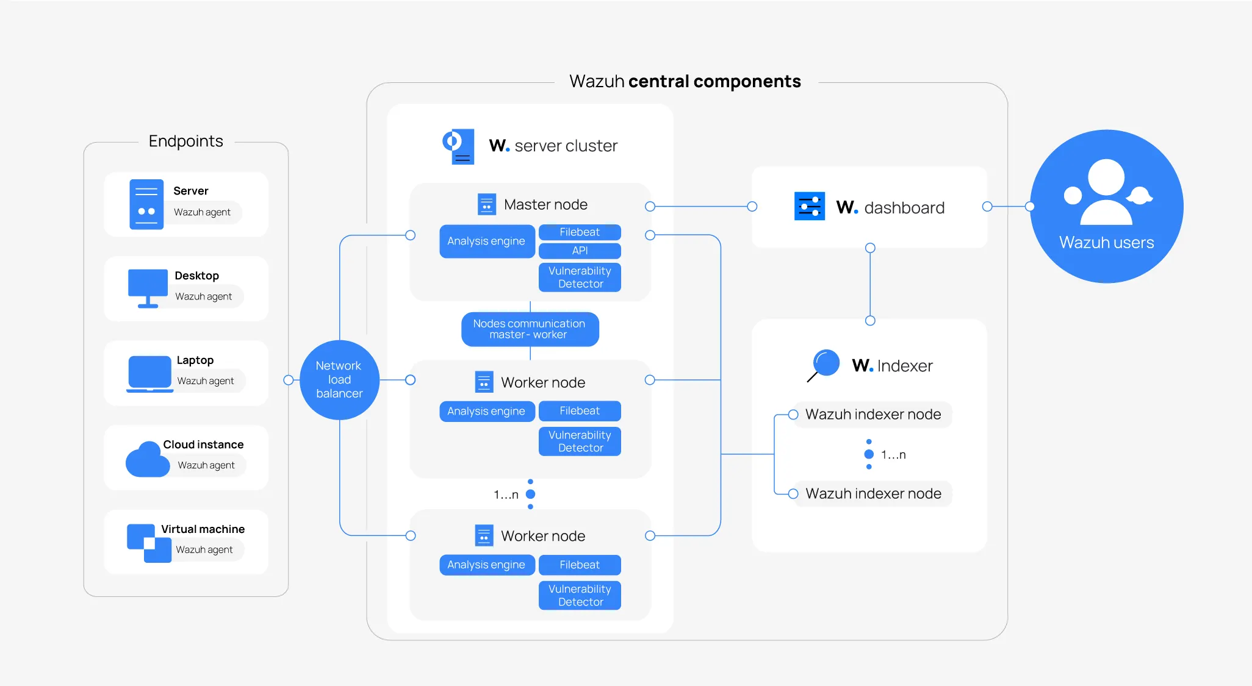
Dashboard – Visualizes and manages data
Agent – Collects data from endpoints
Indexer – Stores and indexes alerts
Manager – Decodes and analyzes events

Slide 5
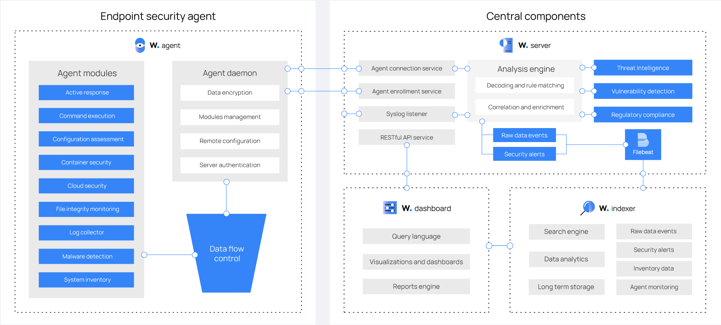

Slide 6


Lab Setup:
VPS
Wazuh Manager + Indexer + Dashboard
T4
STUDENTS
T1
WINDOWS 10 BOB
T1
ATTACKER
The Manager, Indexer, and Dashboard are running on our main VPS
We have one agent ready to send data at wazuh vps.
The dashboard is reachable and responsive from students side. (details will be provided soon)

Slide 7
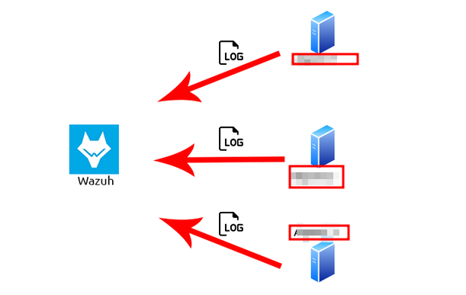
Collecting and Monitoring Logs with Wazuh: Data Sources and Integration Methods
Linux /var/log/syslog, /var/log/auth.log…
Windows Event Logs
Apache/Nginx logs
AWS CloudTrail / Cloud services
Firewalls / Network devices
WINDOWS
LINUX
NET DEVICES

Slide 8
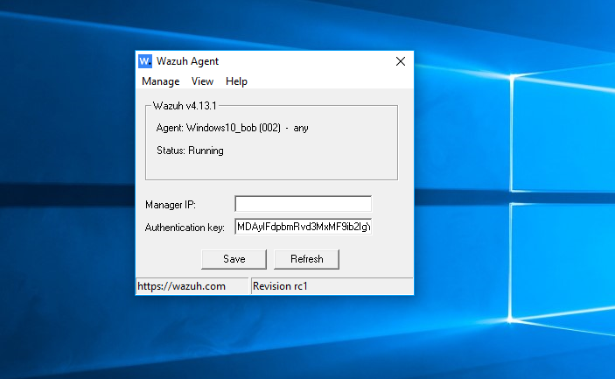
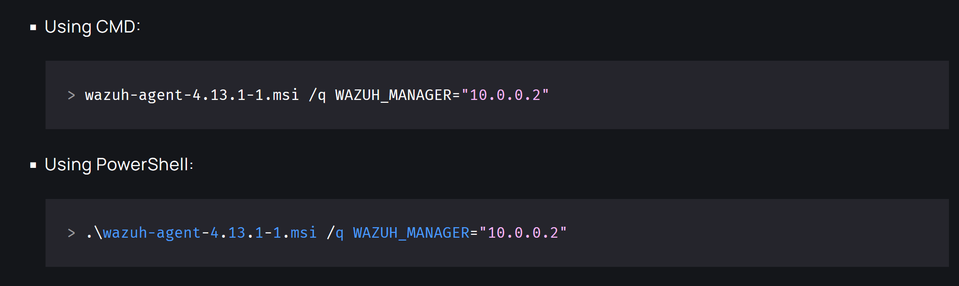
Agent Setup & Configuration (Windows)
Deploying and Configuring Wazuh Agents on Windows Connecting to the Wazuh Manager

Slide 9
Rule Engine & Decoders Basics
Understanding Wazuh Rules & Decoders From Windows Event Logs to Alerts
Raw Windows Event Log
Decoder
Rule Engine
Alert

Slide 10

Threat Hunting with Wazuh
Detecting Brute Force, Privilege Escalation & Persistence on Windows
Brute Force: multiple failed login attempts
Privilege Escalation: Admin account modifications
Persistence: Scheduled tasks, startup registry changes

Slide 11
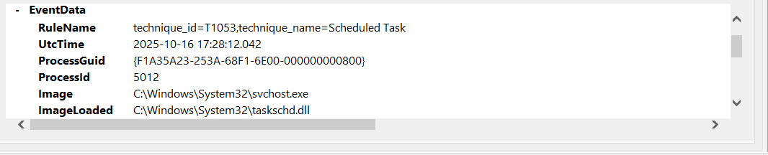
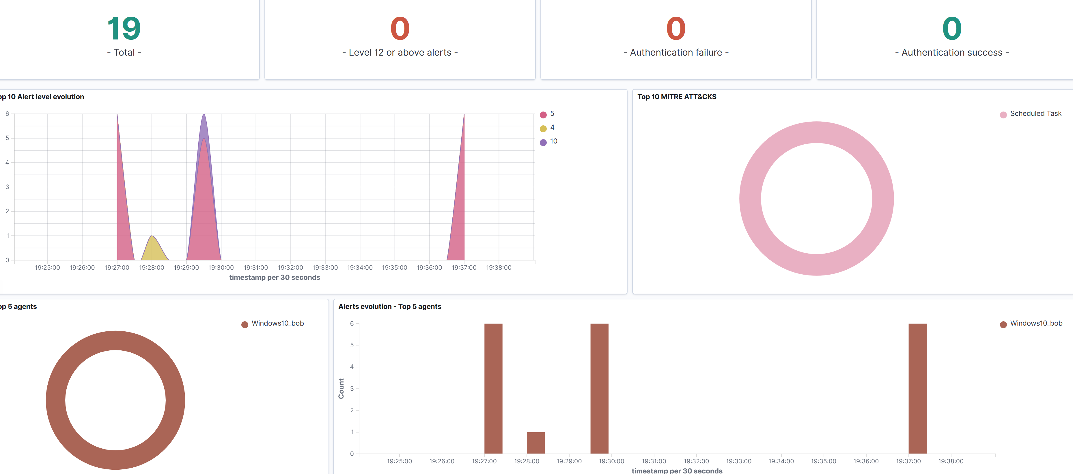
Querying, Dashboards & Alert Interpretation
Turning Raw Events into Actionable Insights

Slide 12
Day 1 Summary & Key Takeaways
Wazuh overview & architecture
Windows agent installed and sending logs (trainer-managed)
Log collection & decoding from Windows endpoints
Rule engine basics & alert generation
Querying & Dashboard insights
Tomorrow: Threat Hunting session based on real time attacks on Windows Endpoint Monitored by Wazuh

